Slide 1

GLOBAL EMISSION OUTPUTS VS COUNTRY GDP
ANALYSIS BY: VIRGINIA MWAPE, DOUGLAS ROBERTSON & CHENG TAN

Slide 2
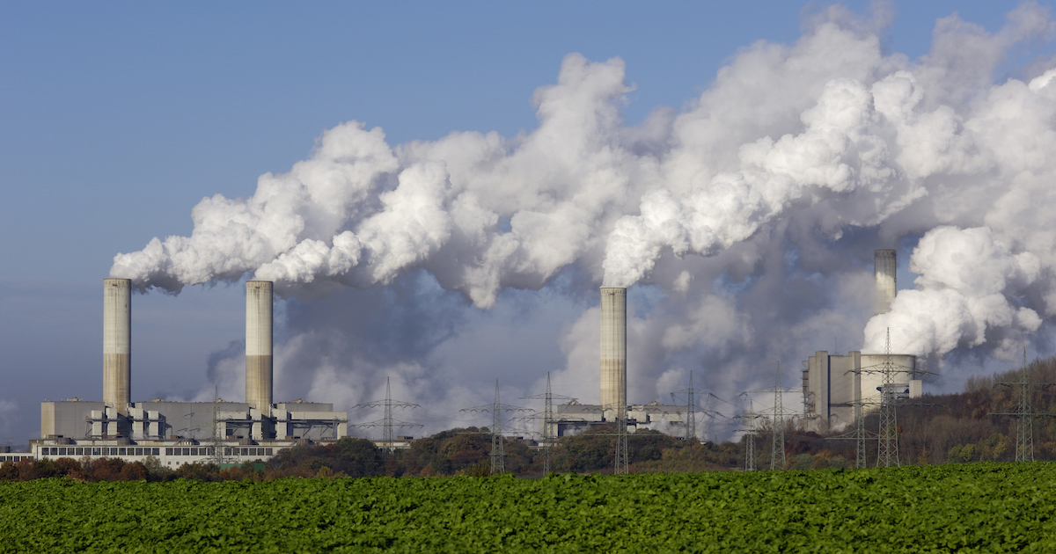
INTRODUCTION, MOTIVATION AND METHODOLOGY
Hypothesis - “As a country’s GDP increases does emissions (CO2e) decrease?”
Do you think there is a correlation?
Notes:
DOUG
* Define the core message or hypothesis of your project.
Logical explanation would be as gdp increases means more economic activity and therefore more GHG. However, might it be that technology improvements, outsourcing and cleaner manufacturing systems change this e.g. aus mining industry going electric. Investigate emissions as countries transition into first world. We looked at regions, income groups and then some specific country examples.
* Describe the questions you asked, and _why_ you asked them
Metric tons of carbon dioxide equivalent (CO2e) represents an amount of a green house gas (GHG) whose atmospheric impact has been standardized to that of one unit mass of carbon dioxide (CO2), based on the global warming potential (GWP) of the gas. This has become a larger topic in the media in recent years particularly on what individuals can do to change/improve things. Therefore we felt it important to understand from a macro-economic “bigger picture” view what this actually means.
* Describe whether you were able to answer these questions to your satisfaction, and briefly summarise your findings
Yes and no. Complex issue that has many interrelated factors we can’t account for.

Slide 3
Questions
Does CO2e emissions have a relationship to a country or regions?
Are there other factors such as a country or region’s income group?
What does this look like in terms of individual country basis?
Data
Data chosen from The World Bank
Reliable, free access and widely accepted as being a reputable source
Previous experience drawing on data from class (important due to small project timeframe)
Taking data from one source reduces discrepancies and improves merge-ability
Kaggle had alternative data options but they weren’t related as specifically to GDP or emissions. (https://www.kaggle.com/berkeleyearth/climate-change-earth-surface-temperature-data/version/2 )
Notes:
DOUG
* Elaborate on the questions you asked, describing what kinds of data you needed to answer them, and where you found it
Questions were chosen to look at a range of subgroups. This was done to break down countries from 250 to foreseeable options. Can see in bold the key areas we needed data around. Worldbank had all this in one spot, means less discrepancies.
World bank -> reliable, access, reputable, previous experience and had all the data we needed in one spot. Alternative was Kaggle but data formats were more complex and no GDP specific.
China - Income Group = Upper middle / Region = East Asia & Pacific
United States - Income Group = High / Region = North America
Japan - Income Group = High / Region = East Asia & Pacific
Australia - Income Group = High / Region = East Asia & Pacific
India - Income Group = Lower middle / Region = South Asia

Slide 4
Data Cleanup & Exploration
Data Sets:
Three sets of data was downloaded from The World Bank website as csv flat files (CO2e emissions, GDP and region).
Each group member was assigned one each to cleanse, this included:
Removing “NaN” data
Cleaning up data formats (some of data, numbers were provided as “objects” or text).
Removing any “FALSE” data (which were replaced with a 0).
Once each data set was cleaned, they were exported as CSV files for group mates to share and merge with their data.
Due to the set up of some of the data, plotting was difficult unless the dataset were transposed for GDP and emissions over time.
Use of the region data set and “groupby” function helped to format data frames to what we needed.
Notes:
VIRGINIA
* Describe the exploration and cleanup process
* Discuss insights you had while exploring the data that you didn't anticipate - dropping off many countries due to lack of data (NANs)
* Discuss any problems that arose after exploring the data, and how you resolved them - Transposed
* Present and discuss interesting figures developed during exploration, ideally with the help of - We analysed our data using Jupyter Notebook

Slide 5
Data Analysis - GDP and Emission (CO2e) by Regions
Python Commands:
Read Data: the csv files. (Regions, Carbon emission and GDP data)
Viewed data: using head() to understand basic information
Dropping columns and null values.
Merged the dataframes.
Used Groupby operation to group the data into regions
Plotting the data: using Matplotlib, Pandas and Seaborn -Heatmaps
Notes:
*Discuss the steps you took to analyse the data and answer each question you asked in your proposal- Jupyter notebook
*

Slide 6
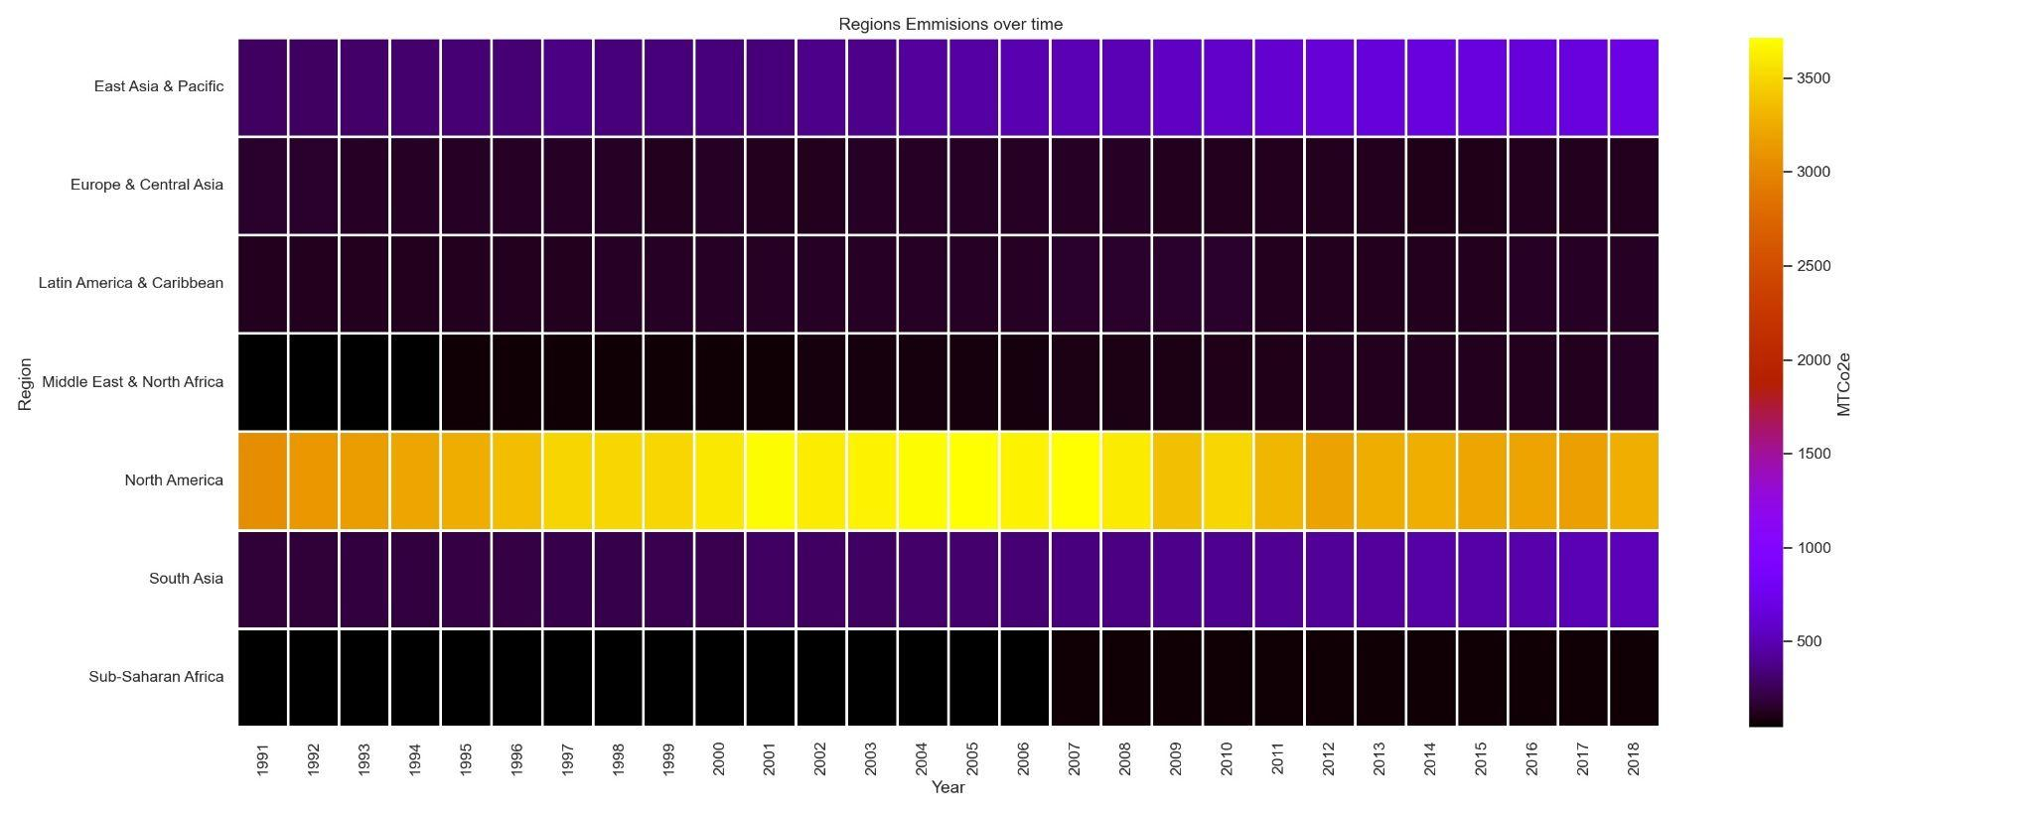
Notes:
Data Analysis - Virginia
Using the colour bar as our reference
North America has the highest emissions over time, followed by East Asia and Pacific, south Asia. Sub saharan Africa had the lowest emission.
North America Emission accelerated in 1997 to 2008, slow down from 2012 - 2008 financial crisis,slowed down manufacturing industries?? may be due to use of natural gas,using wind to replace coal for generating electricity, solar power, more efficient transport

Slide 7
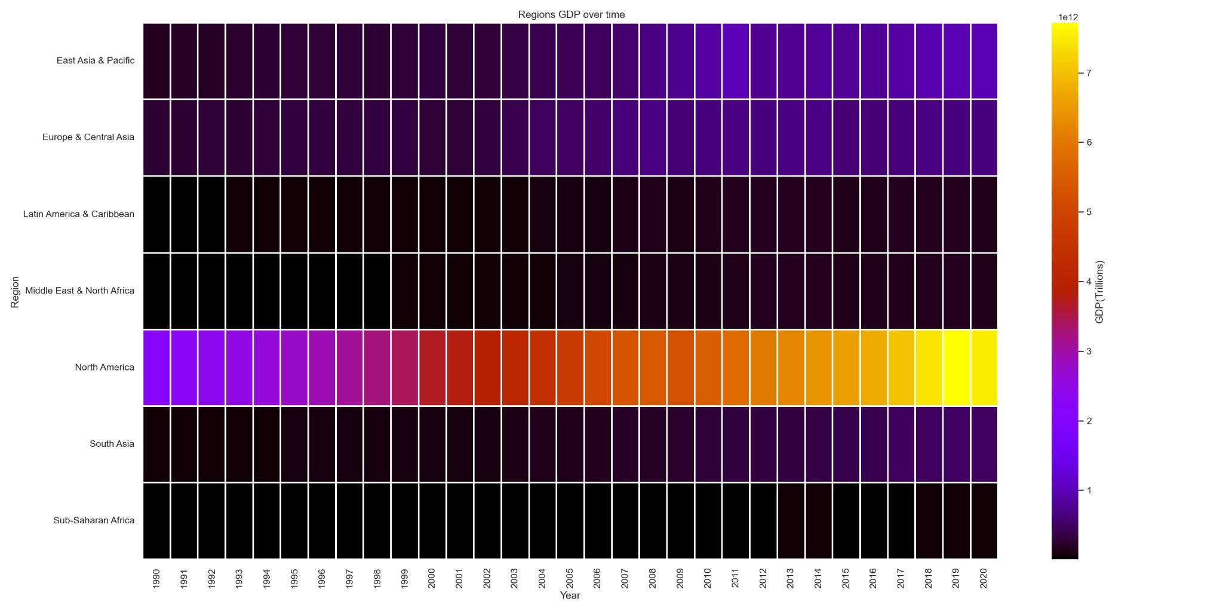
Notes:
*Similar to emissions, North America had the highest GDP over time, with sub saharan Africa having the lowest GDP for the two decades.

Slide 8
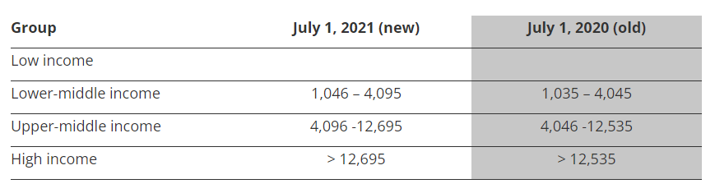
Data Analysis - Income Groups
Reference; https://blogs.worldbank.org/opendata/new-world-bank-country-classifications-income-level-2021-2022
Notes:
Income group based on Gross National Income (GNI) per capita in USD.
GNI - total amount of money earned by a nation’s people and businesses. GNI includes GDP and income from overseas sources.
Classifications updated every year on 1 July.

Slide 9
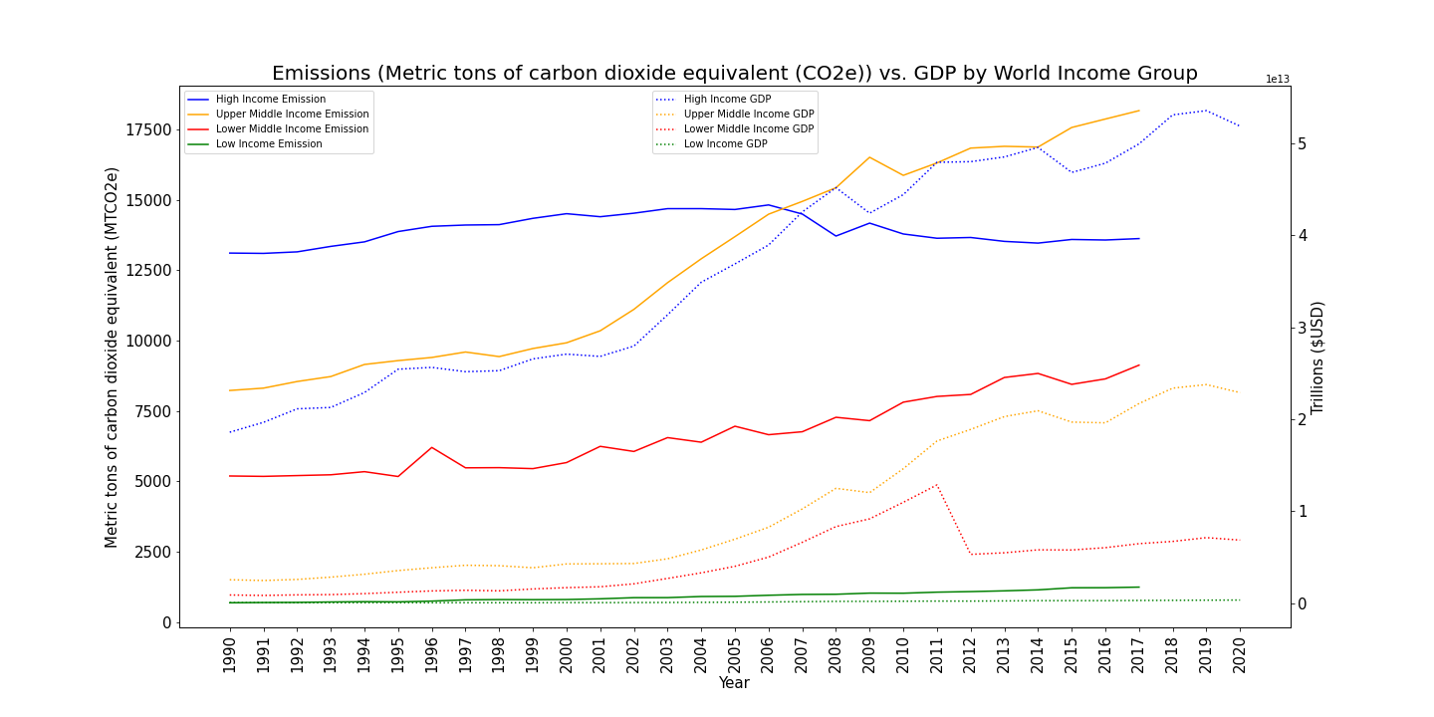
Data Analysis - Income Groups
Notes:
* Used cleaned data from group mates to combine and linked 3 datasets together (region data, emissions and GDP) and used groupby “Income Groups” as defined by the World Bank.
* Plotted total Emissions and total GDP over time from 1990 to 2018(2020) to compare trends.
* This was done to compare the relationship between GDP depending on a countries wealth and its relationship with global emissions.
* “twinx” plot was used to plot the data on two-y-axis.
Interesting findings:
High Income grouped countries emission outputs actually decreased overtime.
It is the only group where GDP continued to increase but emissions actually went down.
Countries in the Upper Middle group, had the most rapid increase in emissions, with total GDP still well below the High Income group (it is disproportionate).
From this we can potentially infer that, High Income countries would potentially have better technology to reduce their emissions, where as the Upper Middle, due to their rapid growth may not be as efficient.
Low and Low-Middle income groups had the lowest emissions totals, which was to be expected.

Slide 10
Data Analysis - Individual Countries
GDP and Emissions trend on five relevant countries. Countries chosen based on relevance to target audience.
Originally, graphed emissions and gdp on two separate graphs but trends were hard to identify.
Later combined using twin y axis for better analysis.
Country | Income Group | Region
United States | High | North America
Japan | High | East Asia & Pacific
Australia | High | East Asia & Pacific
India | Lower middle | South Asia
China | Upper middle | East Asia & Pacific
Notes:
* Discuss the steps you took to analyse the data and answer each question you asked in your proposal
Plotted individual line graphs for 5 countries of focus, originally starting with GDP and Emissions separately. You could see the upwards trend but not the data
* Present and discuss interesting figures developed during analysis, ideally with the help of Jupyter Notebook
General upwards trend for GDP as expected with population growth
Some spikes in emissions and also a downward trend
Some countries better than others

Slide 11
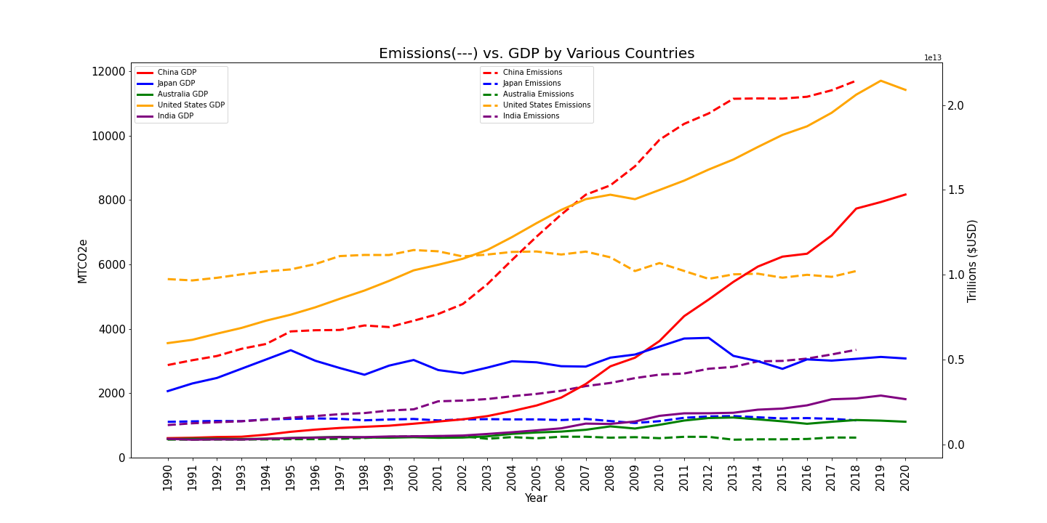
Data Analysis - Individual Countries
Notes:
* Discuss the steps you took to analyse the data and answer each question you asked in your proposal
* “twinx” plot was used to plot the data on two-y-axis.
MTCo2e (Metric Tonnes carbon dioxide equivalent
GDP and emissions tend to rise in a similar trend as with China (RED) and India(Purple)
US (Yellow) has the most interesting figures. GDP and emissions start separate. Emissions trends down as GDP goes up with 2002 the imaginary intersect point.
If we just look at CHina and US. Seemingly could be exporting e.g. manufacturing leaving US
* Present and discuss interesting figures developed during analysis, ideally with the help of Jupyter Notebook

Slide 12
Discussion
Output from analysis on the surface made sense to us.
That being said:
Further investigation would be required as it is a complex issue with factors such as politics, country demographics, technological advancement etc. could not be factored into the analysis.
General conclusion from the data sets we analysed is that GDP in general does appear to have an impact on emission outputs and total GDP wealth can be seen to be concentrated to specific region (e.g. North America).
Notes:
Cheng
* Discuss your findings. Did you find what you expected to find? If not, why not? What inferences or general conclusions can you draw from your analysis?

Slide 13
Post Mortem
Challenges:
Deciding on a topic/target to explore/analyse within a 1 to 2 week period of time.
Cleaning the data sets (FALSE Values, Changes to floats from objects, Transposing the data for plotting).
Understanding the actual data itself in a short period of time. For example, there are many different ways of measuring a country’s wealth (GDP, GNI etc.) and or emissions (CO2, CO2e, Global Temperatures etc.).
Further Research:
Impact of globalisation (e.g. points in time when manufacturing started to shift from developed nations to developing nations).
More data would always be useful, such a more countries and greater period of time to see more longer term trends.
More time to review potential existing research and literature.
Notes:
Cheng
* Discuss any difficulties that arose, and how you dealt with them
* Discuss any additional questions that came up, but which you didn't have time to answer: What would you research next, if you had two more weeks?
FALSE Values
Change to floats
Transpose columns/rows

Slide 14
Questions
Notes:
Group
* Discuss any difficulties that arose, and how you dealt with them
* Discuss any additional questions that came up, but which you didn't have time to answer: What would you research next, if you had two more weeks?

